Slide 1

Plume College
Taster Day
Mon 29 June 2026
Ofsted November 2023​
‘Students in the Sixth Form experience a high-quality curriculum that is well matched to their needs ... and as a result they achieve well’

Slide 2

Taster Days
Provide
Give
you an idea of the teaching methods and facilities
Allow
you to see how College is different to KS4
you with a snapshot of life and learning at Plume College – no gimmicks!

Slide 3
Plume College Team
Mr Hallam | Assistant Headteacher: Head of College
Mrs Pipe | Student Achievement and Progression Manager
Mrs Demes | Plume College Manager
Mrs Barbrook | College Administrator

Slide 4
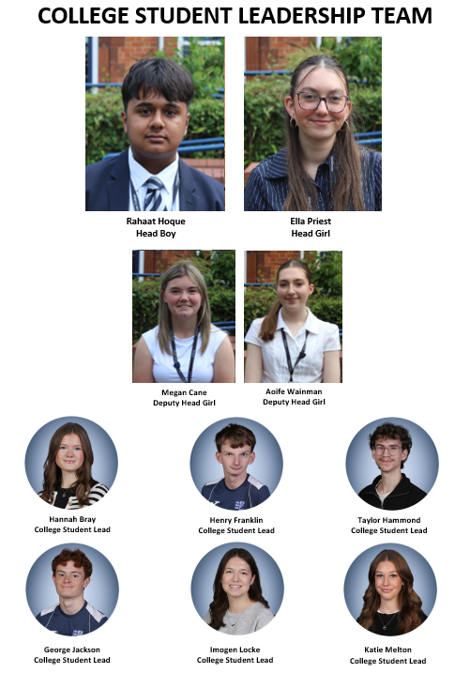
College Student Leadership Team
Head Boy: Rahaat Hoque
Head Girl: Ella Priest
Deputy Head Girl: Megan Cane
Deputy Head Girl: Aoife Wainman
Careers & Mentoring: Hannah Bray
Events: Henry Franklin
Mentoring & Elite Pathways: Taylor Hammond
Careers & Mentoring: George Jackson
Elite Pathways: Imogen Locke
Mentoring & Social Media: Katie Melton

Slide 5
Taster
Day 1
08.50 - 08.55 Period 1 | Registration and Welcome Briefing
10.00 - 11.00 Period 2 | Select an appropriate lesson Photographs for ID/swipe system in College Library
11.00 - 11.15 Break | Morning Break
11.20 - 12.20 Period 3 | Select an appropriate lesson
12.25 - 13.25 Period 4 | Select an appropriate lesson Photographs for ID/swipe system in College Library
13.25 - 14.05 Lunch | Lunch
14.10 - 15.10 Period 5 | Select an appropriate lesson
Monday 29 June 2026

Slide 6
Taster
Day 2
08.50 - 08.55 Period 1 | From 08.45am please sign in outside the College Office Period 1 – select an appropriate lesson
10.00 - 11.00 Period 2 | Select an appropriate lesson
11.00 - 11.15 Break | Morning Break
11.20 - 12.20 Period 3 | Select an appropriate lesson
12.25 - 13.25 Period 4 | Select an appropriate lesson
13.25 - 14.05 Lunch | Lunch Photographs for ID/swipe system in College Library
14.10 - 15.10 Period 5 | Select an appropriate lesson
Mon 30 July 2026

Slide 7
Why Plume?

Slide 8
Why Plume?
Smaller College than many
Separate College building plus dedicated study rooms
For internal students – the staff will know you well
For external students – staff will get to understand you quickly
Strong pastoral care (more later)
Wide range of subjects
History of high achievement

Slide 9
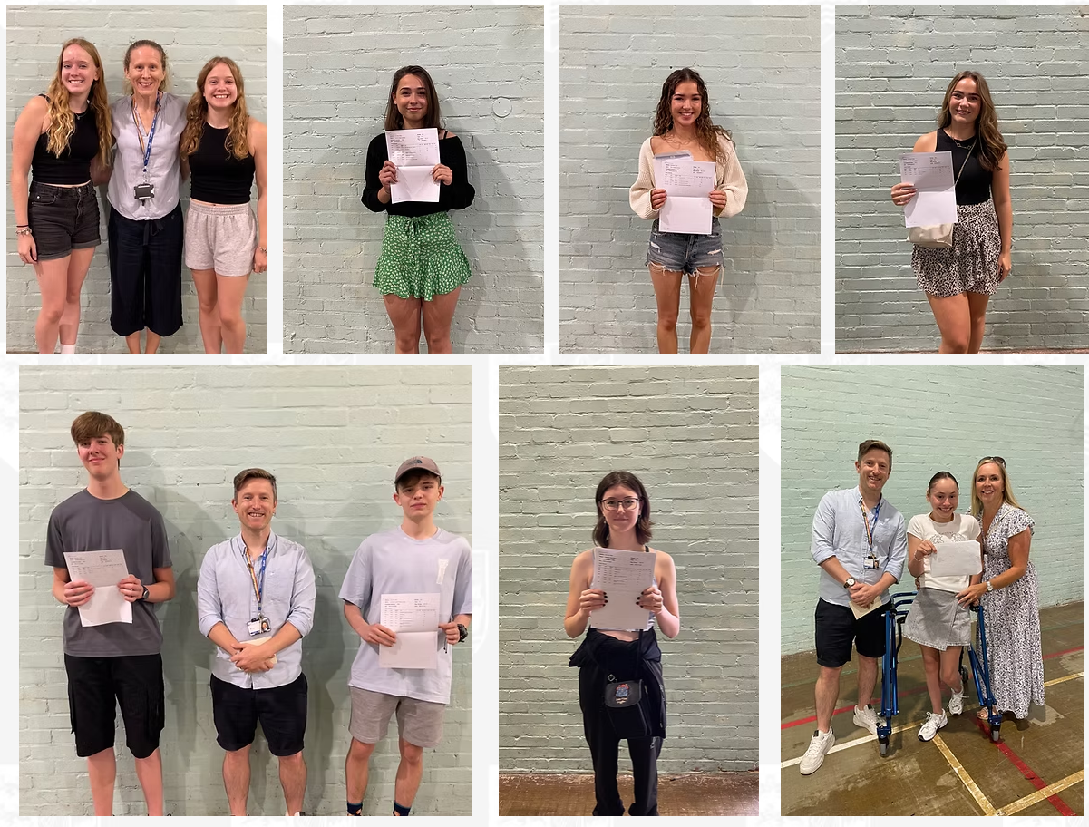

History of Achievement
Each year, the government publishes Key Stage Five performance data, highlighting achievement at A Level and other Level 3 programmes. In February, the tables for the Summer 2024 examination series were published and we are delighted to report that Plume Academy has registered the highest for sixth form progress (Value Added) rate of any school in Essex
Number 1 in Essex for Value Added (VA)​
24th in the country (out of 4000!)

Slide 10
Support

Slide 11
Support at Plume College
If you are struggling with your mental health, physical health, stress, workload etc. – There is a lot of support available to you.
  Your Tutor
  College team
  Counselling
  Mentoring
  Community Mentoring
My vision – ‘a successful, supportive and student-centred College’

Slide 12


Oxbridge/Medicine/Veterinary/
Dentistry
Provision and support will be available for all students who wish to apply to Oxford or Cambridge or for the early entry courses
If you are thinking of applying for any of these courses, I will be personally working with you to ensure you have all of the information and support needed
We will begin this process midway through Year 12 with a trip to Cambridge University

Slide 13
Is College the right option?

Slide 14
College in General
College is a completely different experience to main school
  Less subjects
  More independence
  Different interactions with teachers
  Freedom/Privileges

Slide 15
Independent Work
The levels of this will be increased as the course progresses
Far greater expectation on you to look over things that you do not understand.
A Level is not just about completing set homework, for those of you aspiring for top grades you need to be reading around your subjects.
We have developed a thorough tutorial programme that will develop your independent study skills

Slide 16
Study Periods
When not in lesson you need to manage your study time.
Compulsory Study Time (CST) will be allocated to your timetable. During this time, you will be in the College Study Room
Study periods are an opportunity to carry out independent study (as well as homework).
Students who make the best use of these will achieve well

Slide 17
Need to know

Slide 18





Sixth Form vs College
No uniform/business attire
In school for lesson time only
Freedom

Slide 19
Students whose attendance drops will have support to get back on track
Period 6 – any student who misses a lesson (and are marked present in previous lessons), will be given a P6 to make up the ‘lost learning’
If attendance falls below 92.5%, students will move to Step 1 of the College Behaviour and Expectations Policy
Please note, we will take into account medical reasons, University visits etc. and make decisions on a student-by-student basis.
Attendance
As a College we consider 95% attendance to be 'good’

Slide 20
Like attendance, punctuality is important at Plume College. Missing the start of the lesson is not best for learning, but it is also an indicator of attitude
On top of exam success, we are also trying to prepare you for the world of work (where being punctual is non-negotiable)
If a student is late 3 times in a week, they receive a late sanction and receive a lunch-time detention with one of the College Team
Punctuality

Slide 21
Plume College General Dress/Behaviour
College students are role models:
Year 12 and 13 students are allowed to use their mobile phones, but only in the College area. If students use their phones in the main school building they will be confiscated by staff
Students are expected to wear clean, safe and functional clothing which is always appropriate to the study they are undertaking and environment in which they are learning
Decisions are at the discretion of Mr Hallam or Mrs Pipe

Slide 22
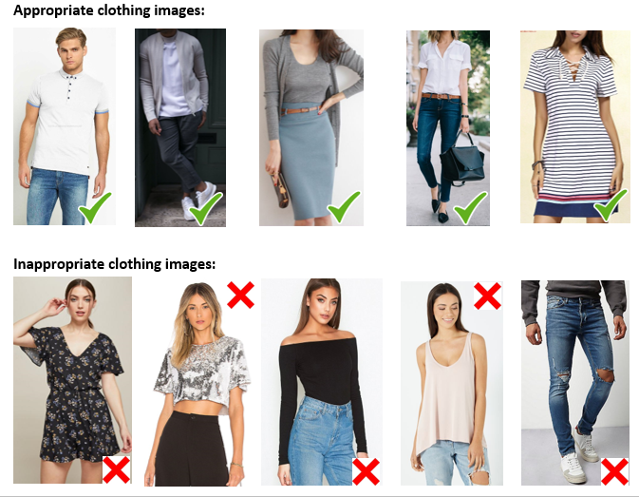
Plume College Dress Code September 2026

Slide 23
Getting in

Slide 24
GCSE Results Day- Thursday 20 August 2026
KS4 (Year 11):
GCSE/Level 2 BTEC/Cambridge National results
Date: Thursday 20 August 2026
Venue: Sports Hall
Year 11 GCSE results at 8:30am
A letter has been sent home to outline the arrangements for GCSE Results Day.

Slide 25
Enrolment Day- Thursday 20 August 2026
Plume College Enrolment Day (for ALL students in Year 11 only)
Date: Thursday 20 August 2026
Venue: Plume College
A letter will be sent home to outline the arrangements for Plume College enrolment day.
Session 1 09:30 - 12:00 Plume students | Session 2 13:00 – 15:00 External students

Slide 26
Enrolment Day – Second Day!
Plume College Enrolment Day (for ALL students in Year 11 only)
Date: Friday 21 August 2026
Venue: Plume College
Time: 10.00 to 14.00
This is for students who are unable to register on Thursday 20 August 2026 and by appointment only
For an appointment, please call the Plume College Office on 01621 879830 or email Mrs Demes, College Manager k.demes@plume.essex.sch.uk

Slide 27
Entry Requirements
Plume College Prospectus:
Please review the Plume College prospectus to confirm the entry requirements for the subjects you wish to study.
https://www.plume.essex.sch.uk/sixth-form-college
Level 3: students must achieve 5 GCSEs x grade 4’s (or higher) including English Language grade 4 and English Literature grade 4
Level 2: students must achieve 4 GCSEs x grade 3’s or higher

Slide 28
GCSE English and Maths Resits
Government Post 16 Requirement:
Students who do not achieve a grade 4 in GCSE Maths and/or GCSE English MUST resit in Year 12 and Year 13 until a grade 4 is achieved.
Students will be allocated timetabled lessons to support this

Slide 29
Taster Day Guidance

Slide 30
Taster Day Guidance
Attend as many sessions as possible – you should fill your day
  You could visit as many as 9 different subjects!
  If a lesson is busy (some rooms will fill up), there will be another chance to see attend later that day or the next
  Try different versions of each subject e.g. A Level vs CTECH Business
  Consider options you may not know about e.g. ….

Slide 31
EPQ
Extended Project Qualification (EPQ) – TIE BREAKER!
The work, which is worth the equivalent of half an A-level, is usually presented as a 5000 word report in an academic subject ‘outside their main programme of study’.
It requires a high level of independent work and original thought – skills which universities complain are lacking in school leavers.
Universities said EPQs can make the difference between winning a place on a course or just missing out.
Interested in EPQ? – attend the taster session or see Mr Carlsson for more details.
Students must have a grade 4 in GCSE English Language, a high level of motivation, enjoy independent study and coursework

Slide 32

CORE MATHS
Take it in addition to your 3 main choices
One-year course
Practical applications of Mathematics. Topics such as percentages, personal finance, taxation, graphical techniques, data analysis, estimation techniques, and use of spreadsheets as well as critical path and risk analysis.
Recommended anyone studying one or more of the complementary subjects
  Biology
  Business
  Chemistry
  Geography
  Product Design
  Psychology
A good option if you would like to study for a Maths qualification, but A Level Mathematics is a step too far
Assessed by 2 exams at the end of Year 12.
Attracting up to 20 UCAS points
Entry requirements: GCSE Mathematics Grade 4

Slide 33
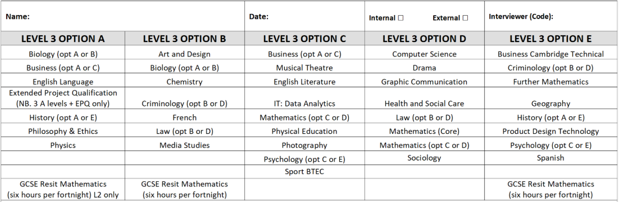
Step 1: Check the option grid for clashes

Slide 34
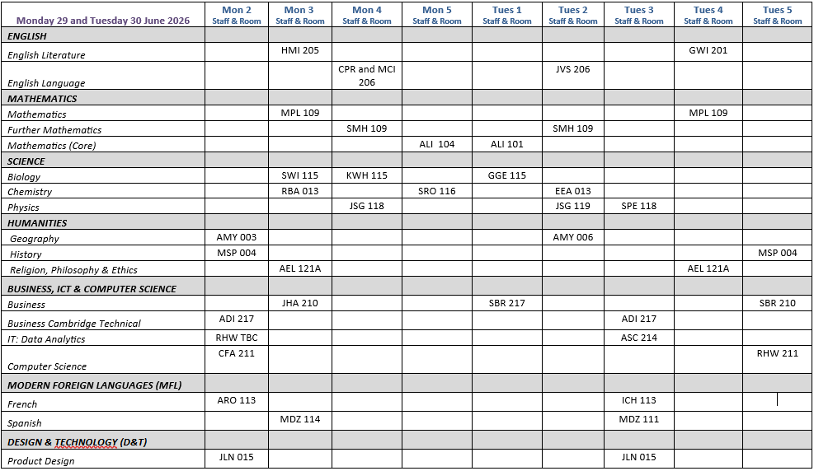
Step 2: Identify the lessons you will attend today & tomorrow

Slide 35
Year 11 into Year 12 Transitional Challenges
Available on the Plume College webpage
Work is provided to give you an indication of the ‘step up’ to A level
First impressions count! Vital that you engage
Work is assessed to ascertain student suitability for each subject area
More information will be provided during the taster sessions
Please be aware that staff will be asked to report on the relative success of student completion of their Transitional Challenges

Slide 36

Recommendations for Taster Days
Attend as many sessions as possible
Talk to staff - ask questions
Speak to Year 12 about their options
See the College Team if you have option clashes
Taster sessions run all day from the start of Period 2 (10am) and finish Period 5
ID Swipe Card requires a College photograph (P2 & P4)
You can have your photo taken on either Monday or Tuesday
If you need any assistance or have any questions, please do not hesitate to talk to a member of the College team

Slide 37



